Slide 1


CANoe Oscilloscope implementation
More Lives Saved
More Life Lived
Agapi Grigore
SWV

Slide 2
Needed files:
1. OSCILLOSCOPE_Control.cin → Functions for used Oscilloscope control
2.1 Oscilloscope.sysvar → System variables
2.2 Core_Functions_SysVar.vsysvar → System variables
3. PSM_StartValues.svc → Used for oscilloscope configuration
4. Oscilloscope_CANoe_DLL.dll → Functions for USB communication with OSC
PTC location: e:/MKSProjects/SWVR_PP_CI_Activities/CANOE_TEST_PLATFORM/Includes/HW_Modules/OSC/
Implemented and tested on : CANoe Build 15.4.35 (SP4) – 64 bit

Slide 3
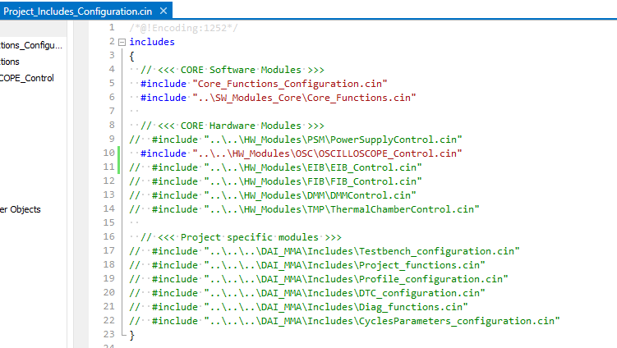
1. OSCILLOSCOPE_Control.cin
Uncomment the include line from “…\Includes\SW_Modules\SW_Modules_Project\Project_Includes_Configuration.cin”
or include the file to any compatible location if the core structure is not used in your project.
”

Slide 4
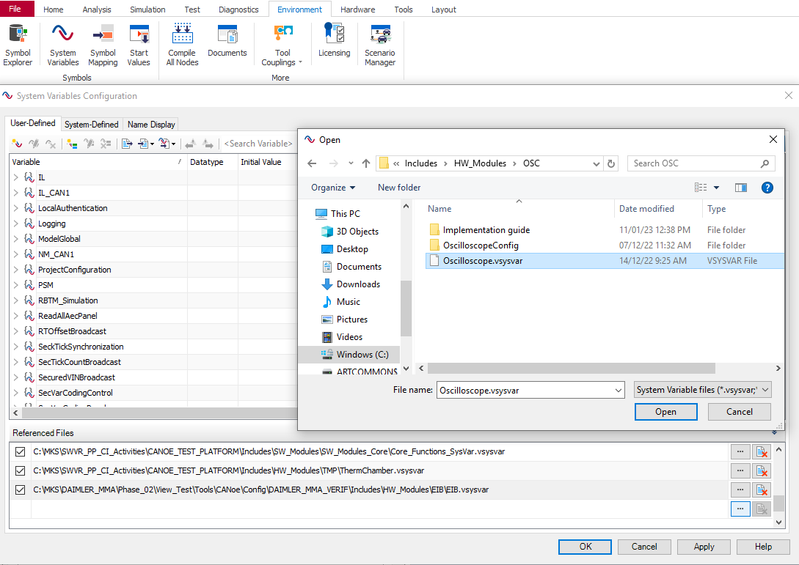
2.1 Oscilloscope.vsysvar
Import to CANoe configuration: (1) Environment → (2) System Variables → (3) Select File → (4 & 5) Open
1
2
4
5
3

Slide 5
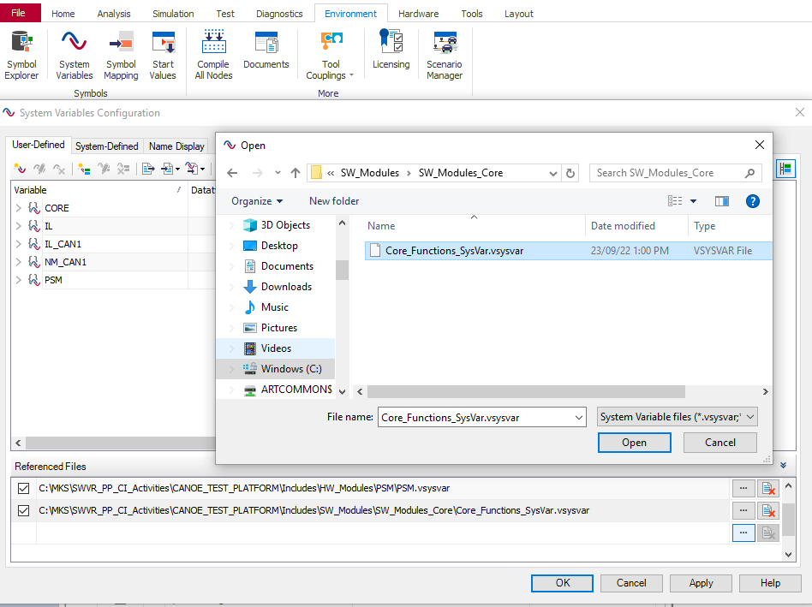
2.1 CORE_Functions_SysVar.vsysvar
Location: e:/MKSProjects/SWVR_PP_CI_Activities/CANOE_TEST_PLATFORM/Includes/SW_Modules/SW_Modules_Core
Import to CANoe configuration: (1) Environment → (2) System Variables → (3) Select File → (4 & 5) Open
1
2
4
5
3

Slide 6
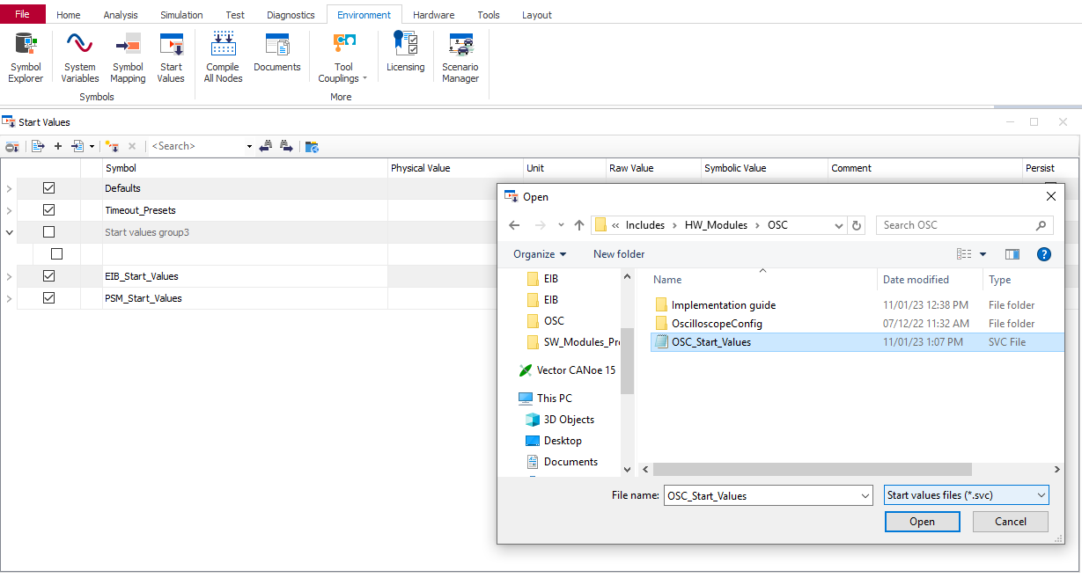
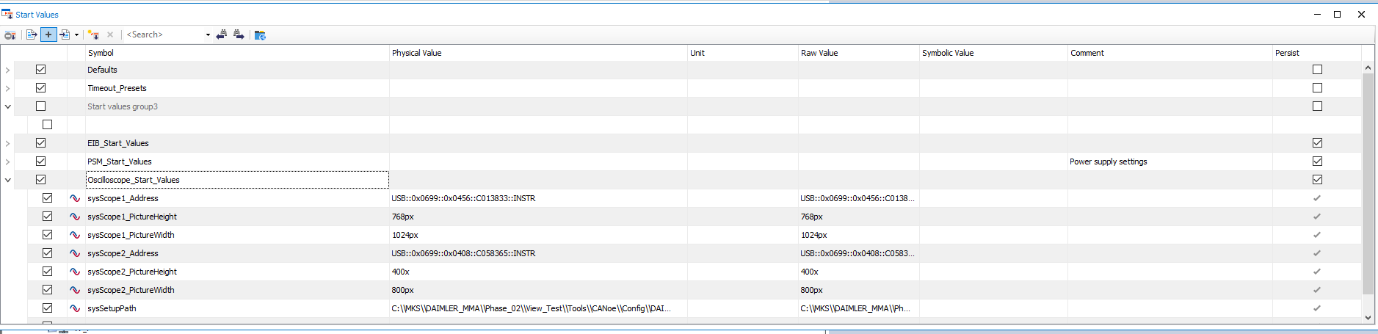
3. OSC_StartValues.svc
Import to CANoe configuration: (1) Environment→ (2) Start Values→ (3) Append (+) → (4) Open OSC_StartValues.svc
IMPORTANT: Save the CANoe configuration before starting the simulation.
The Oscilloscope settings are set through the ‘Start Values’ panel. Configuration is done before simulation start:
1
2
3
4

Slide 7
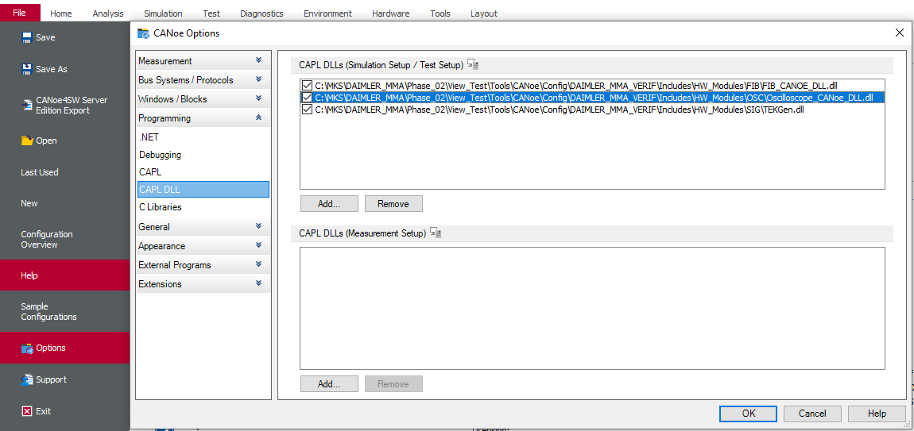
4. Oscilloscope_CANoe_DLL.dll
Add to CANoe configuration: File → Options → Programming → CAPL DLL → Add to “Simulation Setup / Test Setup”
1
3
4
2

Slide 8

Saving More Lives

